Slide 1
ART 2620, Interior Architecture Studio II Spring Semester: Second Half 2019 Grover Center W327 Tuesday & Thursday 1:30 – 4:20PM
Matthew Ziff, M.Arch, Associate Professor, Interior Architecture Chair
Architect, NCIDQ
Grover Center W325
740-593-2869
ziff@ohio.edu
Office hours: TTH: 12:00 - 1:00 MW: 1:00 - 2:00
Design Project: A Hotel Lobby & Public Restroom

Slide 2
This set of interior images is presented with the intention of shaking you up, of energizing your thinking about interior space and interior components such as walls, floors, and ceilings.

Slide 3
Department of Architecture Co., Ltd. Hilton Pattaya : Lobby & ‘Drift’ Bar

Slide 4
Hilton Pattaya : Lobby & ‘Drift’ Bar
The space for the hotel lobby and bar occupies the 16th floor, high above the bustle of Pattaya beach below.
Upon entering the space from one end, as elevator doors open, one would enter a spacious lobby area.
The architectural intervention to the entire ceiling plane, with its dynamic wave lines, leads the movement of the visitors towards the seafront beyond.
The fabric installation on the ceiling becomes a main feature in the space while simple elements on the ground provide a tranquil atmosphere.

Slide 9
Zense Restaurant
To reflect character of the project owner, ZEN Department Store, we introduce the dynamic world of fashion in the static domain of architecture, by adapting aesthetic and technique of pleating fabric into architectural elements and function.
In interior space, pleating elements are found throughout; from pleating stairs and railing, pleating seating, pleating performing stage, to pleating roof planes over show kitchens.
To create energetic flow of the space and to obscure all piping underneath exposed ceiling slab, pleating planes of fine steel lines were added as floating planes below ceiling. These planes are also applied in floating dining pavilions which give such a unique picture frame to Bangkok city skyline.

Slide 15
SunOne Bangkok, Thailand 2009
Located among a low-rise residential neighborhood, a new location for a software developer–SUNONE presents designers with a great challenge dealing with quality of living for existing residence and working condition for the new comer.
In order to preserve serenity of an area, respect privacy for each residence and simultaneously create pleasing working environment for staffs, pattern of horizontal screening was introduced to the project.
Not only does it create visual barrier between inside and outside; allowing no direct sight from inside to surrounding residence, but does it serve as light filter generating array of light quality for interior space.

Slide 16
The main feature of an interior space is the design of interior screen that scattered throughout space.
While exterior screen reflects technological character of company’s field of business, interior screen, on the opposite, directly reflects adventurous personality of the owner and staffs. Industrial material like colorful PVC strip curtain has been incorporated through the building to reflect energy and liveliness of these extreme-sport lovers.
Besides operating as space divider and enclosure, this screen, with its transparency property, also functions as an indicator of an area’s privacy level. By using PVC strip curtains, openness and transparency of office space are maintained.

Slide 21
ARCHSTUDIO

Slide 31
Interior Design Magazine Best of Year Awards Winners 2017

Slide 32
Hotel lobby

Slide 38
“snap to grid”: a very, very useful design thought/tool/gesture

Slide 42
Public restrooms in hotels

Slide 45
snap to grid!

Slide 46
snap to grid!

Slide 49
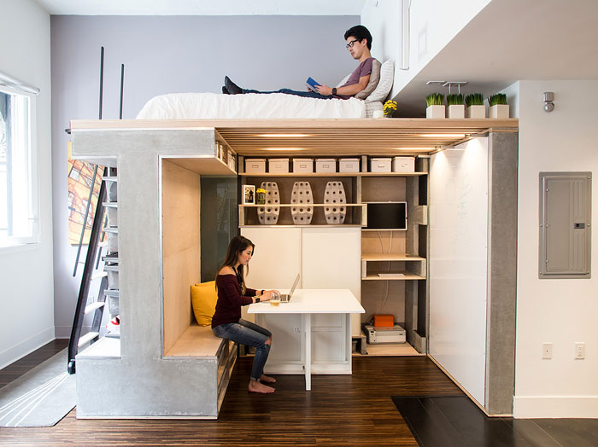
The following ‘small spaces’ are from: 50 Small Studio Apartment Design Ideas (2019) – Modern, Tiny & Clever

